Slide 1
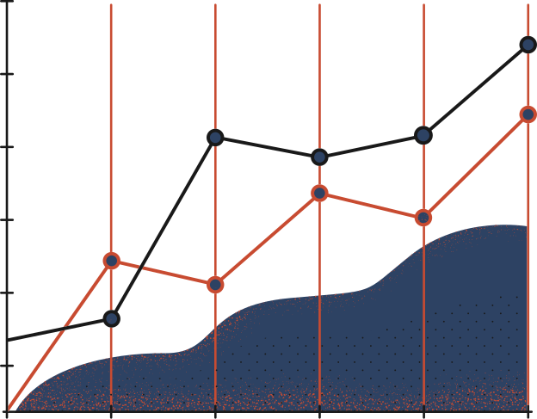

23rd May 2022, Friday
EIED, Thapar University
CYBER GLOVES
FOR
DEAF-MUTISM
STUDENT
MENTOR
Saurabh Kumar
Isha Bajaj
Manan Vig
Aparajita Jha
Dr. Jainy Sachdeva
Associate Professor
EIED

Slide 2
Table of Contents
Page
I
Design Methodology
3
II
Hardware Design
4
III
Hardware Flex Sensor Simulation
5
IV
Hardware Module
6
V
Software Simulation
7
VI
Train Data
8
VII
Test Data
9
VIII
Model Accuracy
10

Slide 3
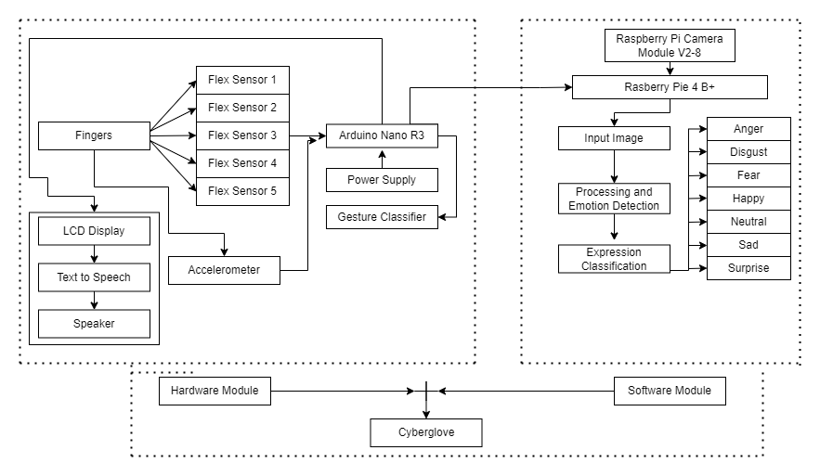
I
Design Methodology
3

Slide 4
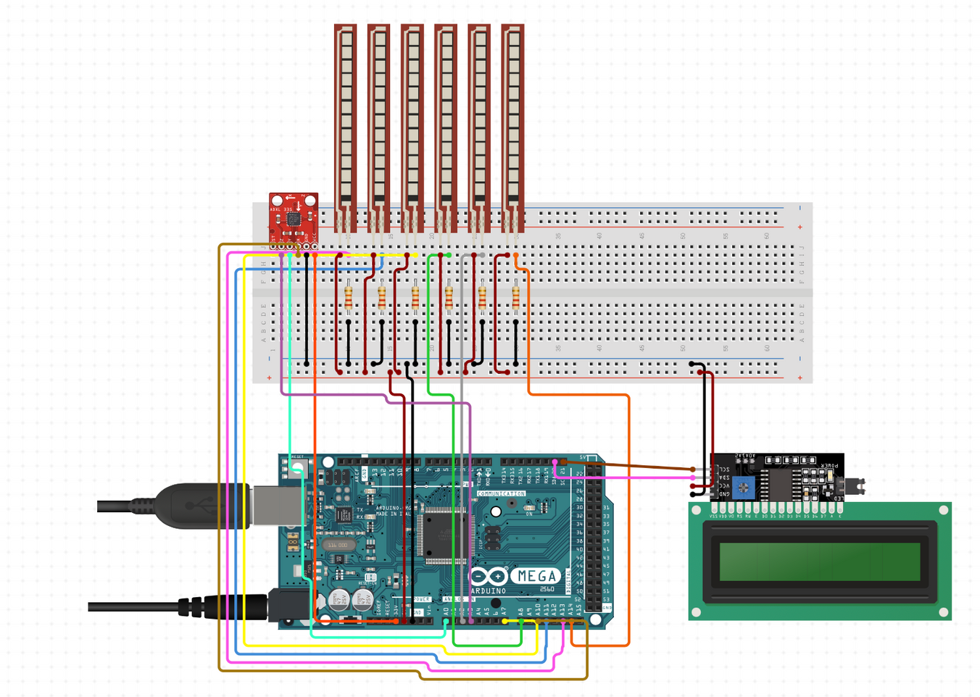
II
Hardware Design
Flex sensors are connected to the analog pins A0 to A4 of an Arduino Microcontroller. This data is taken as input by the controller and can be used further for mathematical calculations for finding various bending angles.
4

Slide 5
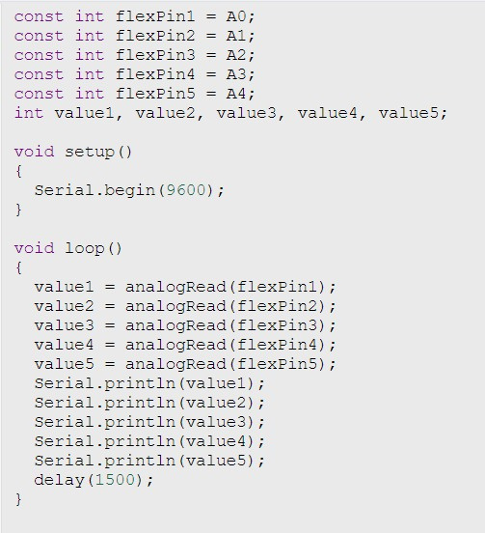
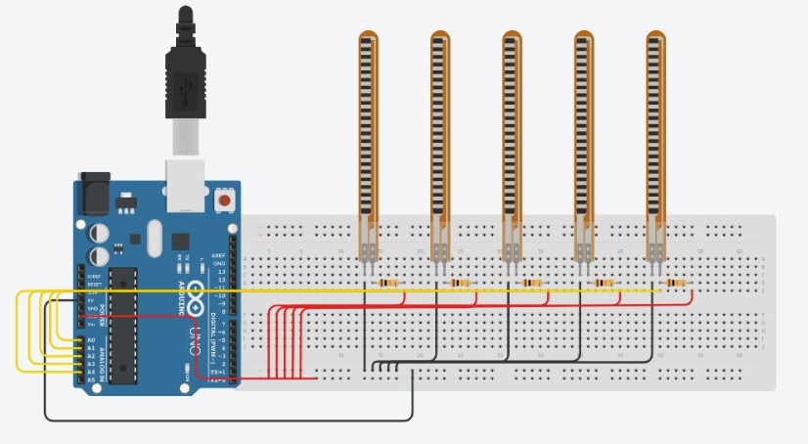
III
Hardware Flex Sensor Simulation
5

Slide 6
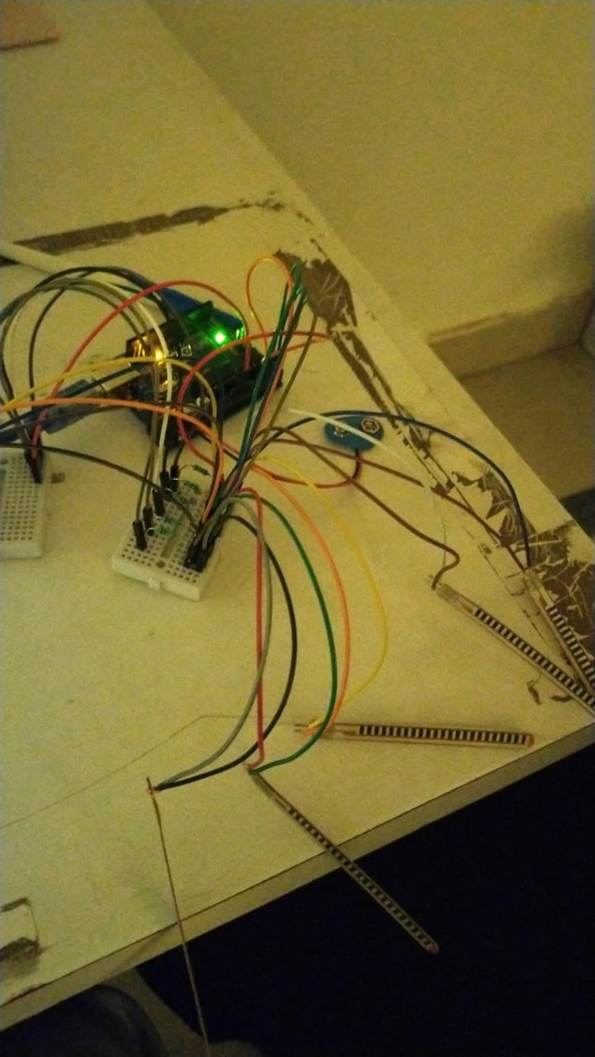
IV
Hardware Module
In the given figure, we have tested all the five sensors and monitored their real time values on the serial monitor of Arduino IDE.
The value of resistance of flex sensor changes with the change of bend angle has been evaluated, and then printed on the serial monitor.
6

Slide 7
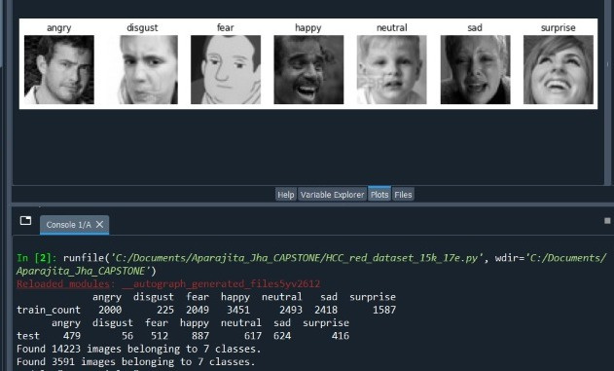
V
Software Simulation
The flow of logic is set by the program by examining into input the image that needs analysis.
The result achieved represents an array of emotions with a value mentioned against each, basically a confusion matrix in the proposed case with 7 classified emotions where the code individually takes images as input and details out various emotions and their separate classification results.

Slide 8
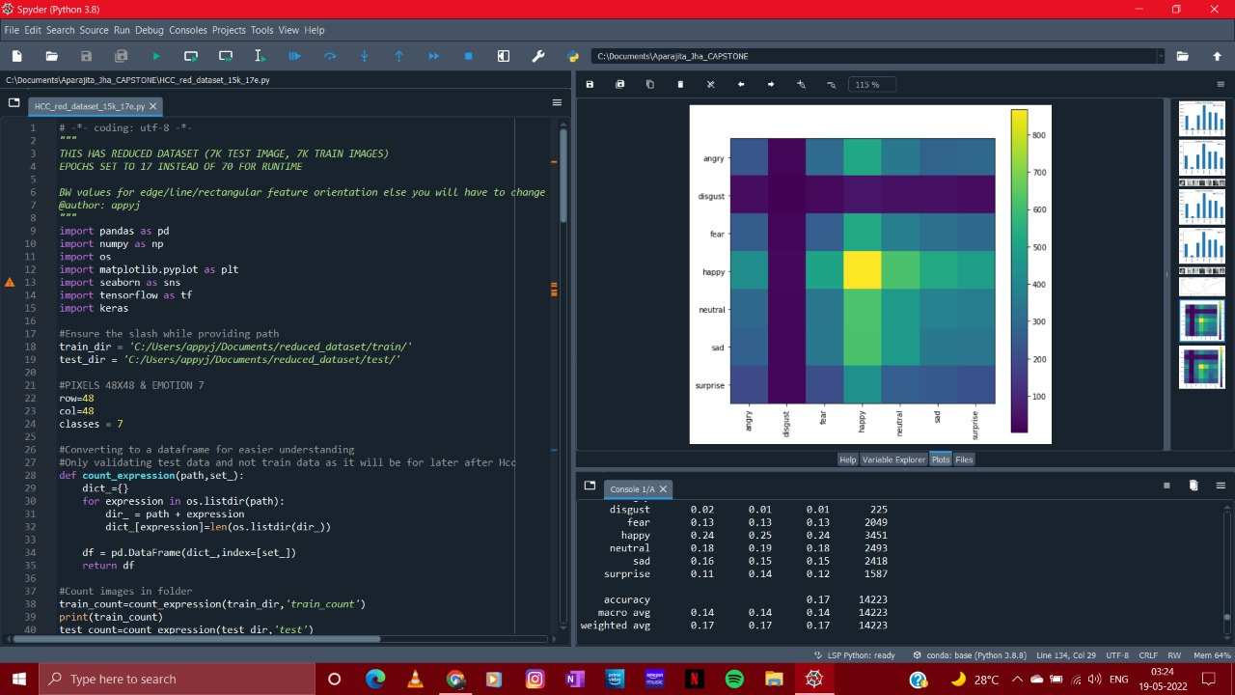
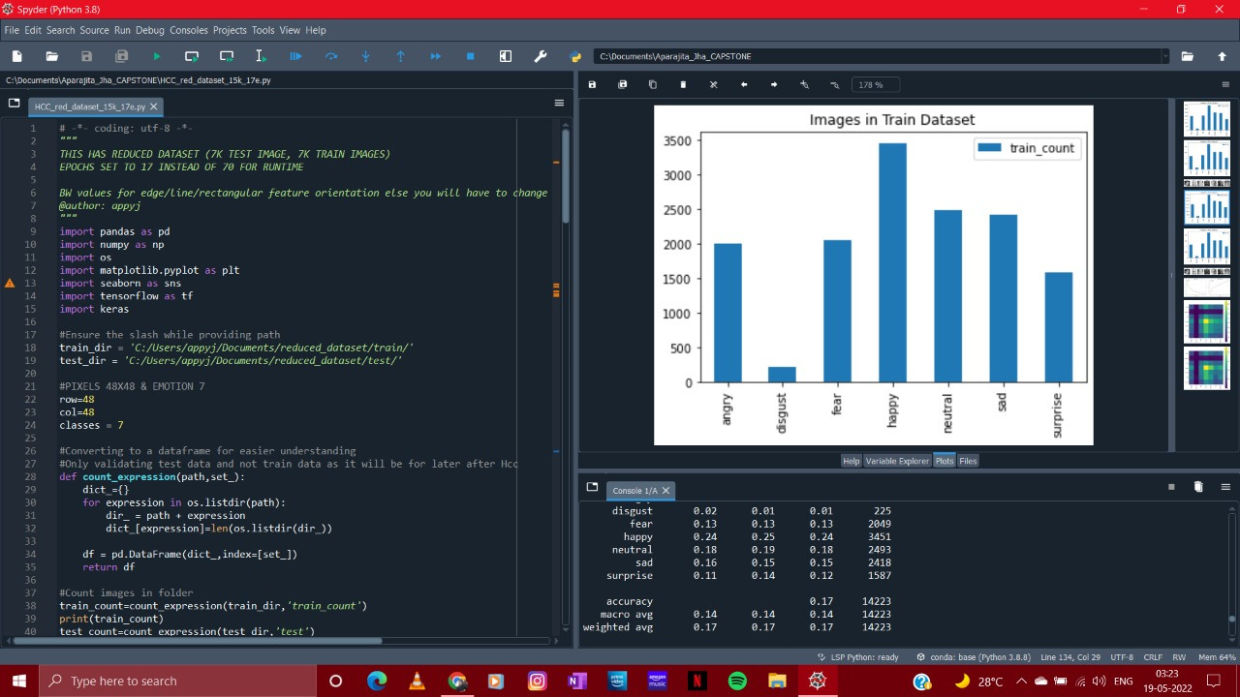
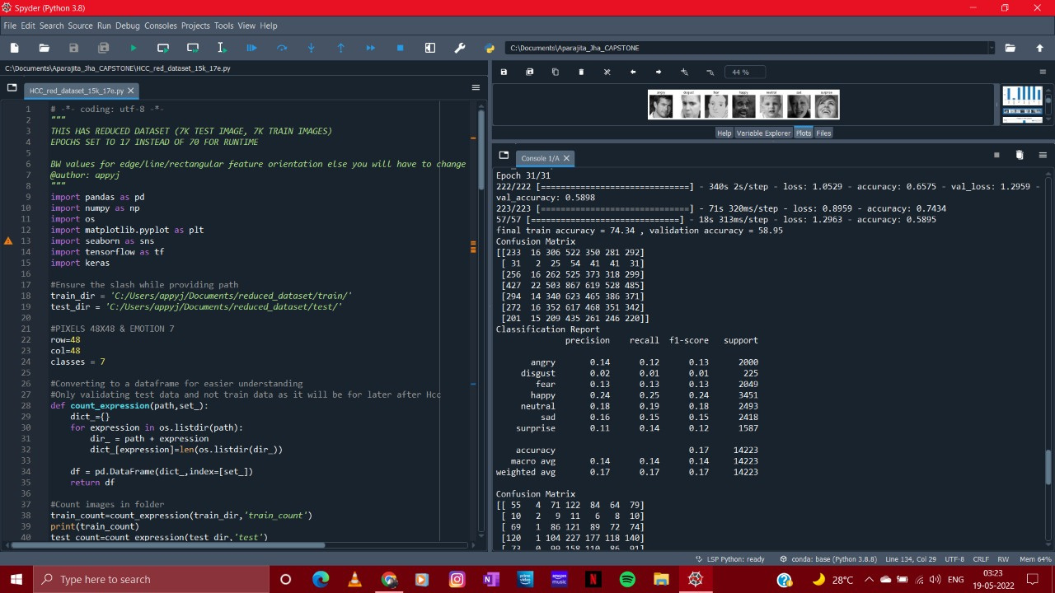
VI
Train Data

Slide 9
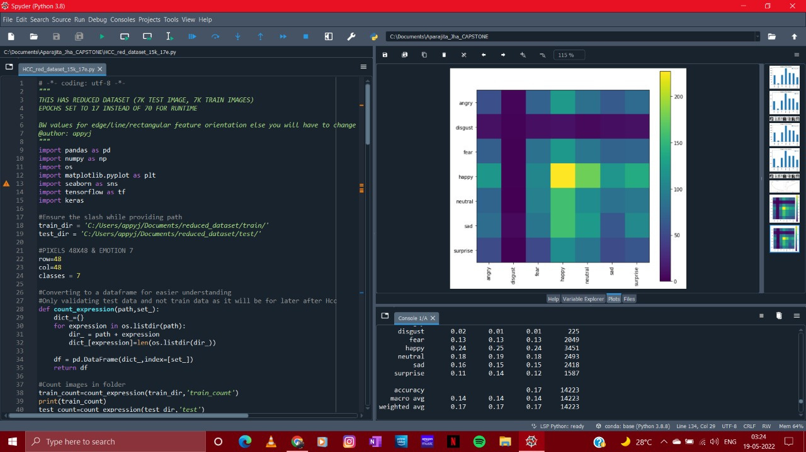
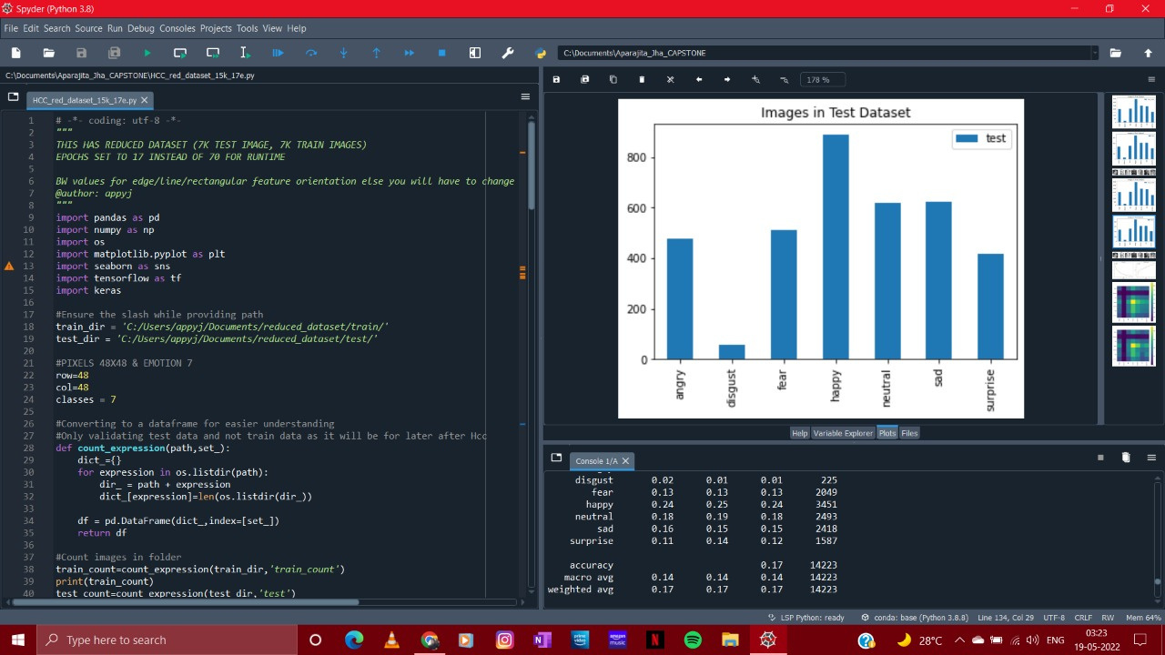
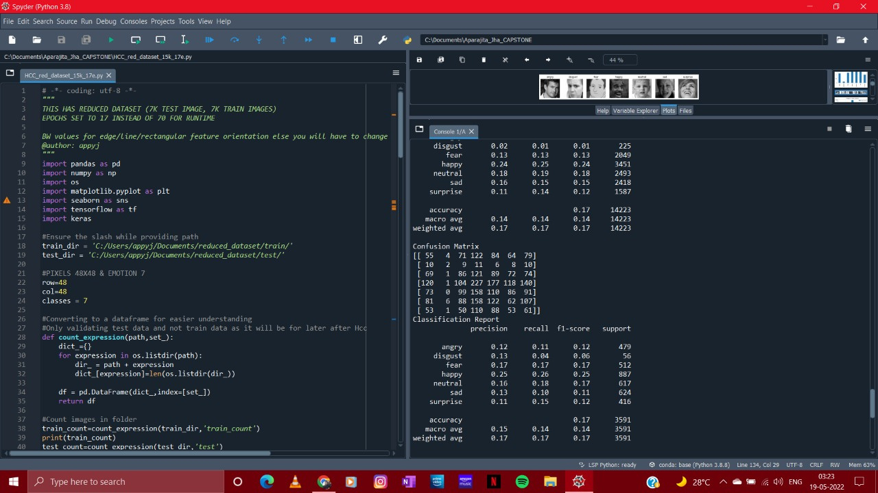
VII
Test Data

Slide 10
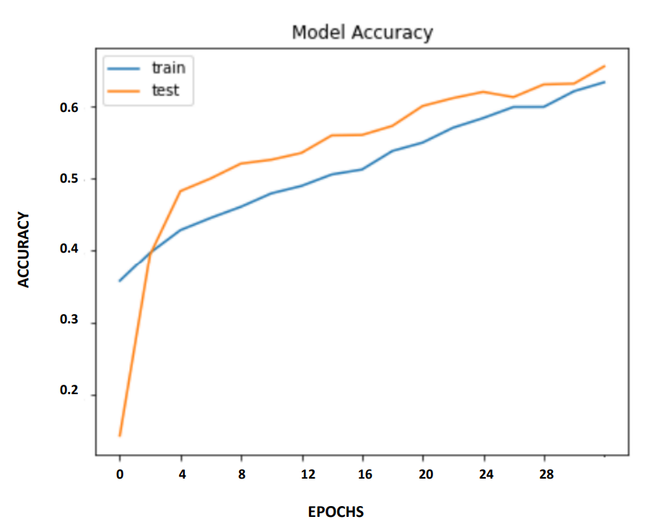
VIII
Model Accuracy
The developed model has an accuracy of 74.34% after 31 Epochs.
This will be further modified to obtain better result.
7

Slide 11

The End
Thank you
for listening

